Slide 1
Using R to Calculate Probabilities from the Normal Distribution
Math 32, Fall 2020
Discussion Section #5

Slide 2
Discussion Section #5
We will continue to learn the basics of R.
We will explore using R to help us answer questions involving the normal distribution.
pnorm
dnorm

Slide 3
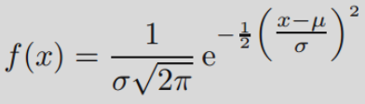
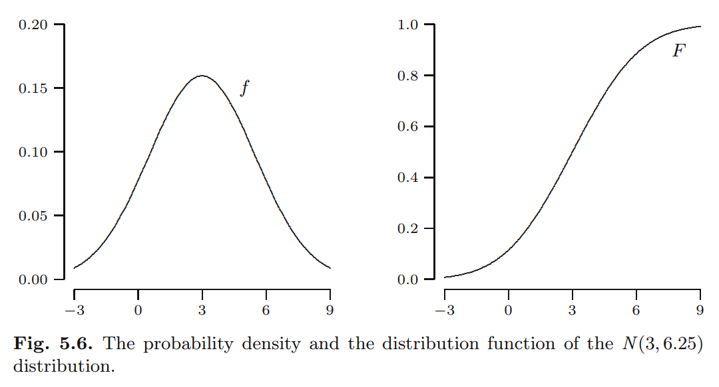
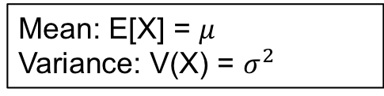
Normal Probability Distribution
Mean: E[X] = $μ$
Variance: V(X) = $σ^{2}$
PDF
CDF

Slide 4
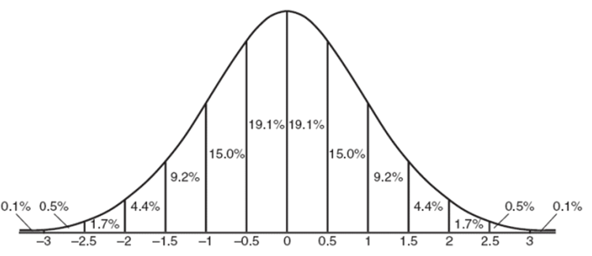
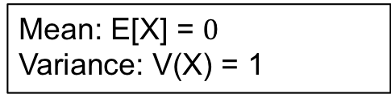
Normal Dist: “68-95-99.7 Rule” or “Empirical Rule”
First published in 1733 by DeMoive
Based on observation
Almost all data falls within μ±3σ
Mean: E[X] = $0$
Variance: V(X) = 1

Slide 5
We will look at 2 ways to solve problems of Normal Distribution Calculations
Online Webtool:
http://onlinestatbook.com/2/calculators/normal.html
R Programming Language
To figure out what any command in R does use: ?command name (> ?pnorm)

Slide 6
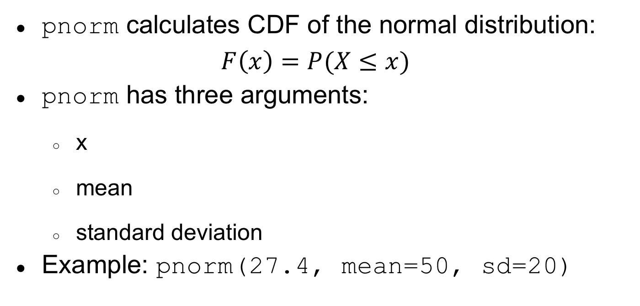
Using the Normal CDF
pnorm calculates CDF of the normal distribution:
$$F\left(x\right)=P(X≤x)$$
pnorm has three arguments:
x
mean
standard deviation
Example: pnorm(27.4, mean=50, sd=20)
> pnorm(27.4, mean=50, sd=20)
[1] 0.1292381

Slide 7
Using the Normal CDF
dnorm calculates PDF of the normal distribution:
dnorm has three arguments:
xrange
mean
standard deviation
Example: dnorm(27.4, mean=50, sd=20)

Slide 8
Using pnorm in R
Probability that a normal random variable with mean 22 and variance 25 lies between 16.2 and 27.5
> pnorm(27.5,22,sd=5)-pnorm(16.2,22,sd=5)
[1] 0.7413095

Slide 9
Using pnorm in R
Probability that a normal random variable with mean 22 and variance 25 is greater than 29 >1-pnorm(29,22,sd=5) [1] 0.08075666

Slide 10
Using pnorm in R
Probability that a normal random variable with mean 22 and variance 25 is less than 17
> pnorm(17,22,sd=5) [1] 0.1586553

Slide 11
Using pnorm in R
Probability that a normal random variable with mean 22 and variance 25 is less than 15 or greater than 25 > pnorm(15,22,sd=5)+1-pnorm(25,22,sd=5) [1] 0.3550098

Slide 12
Normal Distributions: Manufacturing Example
The R code ‘Lab05_ClassExample.R’ solves the following example from Lecture 10. Your TA will review the problem and code with you. A manufacturer is producing a ¾ -inch threaded rod. It is determined that the diameter of the rod follows a N(0.75,0.001) distribution.
(a) If the manufacture must throw out any rod that is not within 0.0014” of 0.75”, determine the percentage of the rods that will be discarded.
(b) Management wants to bring waste under 5%, what standard deviation must be attained to make this happen?

Slide 13
Lab #5 Assignment
In this class you will do the following.
Answer the questions on Lab05.pdf.
Each question must include both a picture (shaded normal distribution) and the calculation/solution.
You must use complete sentences.
You do not need to hand in a R script.
Submit your Lab Write up (Word/PDF, etc)
Note: For full credit on any question involving a normal distribution, you must also plot the shaded region of a Normal PDF

